Slide 1
TSCC Fall 2016 Meeting
Nov 7, 2016 (Monday) – 13:00 MST
Renaissance Hotel & Spa
Glendale, AZ
(ITC)

Slide 2
Abridged Agenda
RF Working Group Discussion
Officer Reports
Chair D. Corry
Secretary-Treasurer W. Klein
Vote on New members D. Corry
Committee Reports
Nominating Committee B. Fleury
Radio Frequency S. Brierley
Data Multiplex B. Fleury
Networking and Protocols D. Corry
Transducers L. Eccles
Coding/Data Compression S. Nicolo
Recorder / Reproducer M. Buckley
ETSC Report G. Mayer
Website
Confluence/Feedback on stadards D. Corry/B. Baggerman
AOB D. Corry

Slide 3
Welcome
Confirmation of Quorum
Diarmuid Corry is chair.

Slide 4
Committee Reports

Slide 5
TSCC Spring 2016
Nominating
Subcommittee Report

Slide 6
Nominating Sub-Committee Membership
Current Nominating Subcommittee Membership
  Brad Fleury (chair) – Edge Consulting
  Stephen Nicolo – GDP Space Systems
  Scott Brierley - United Launch Alliance
  Wayne Klein – Apogee Labs
Notes:
6

Slide 7
Sub-Committee Focus
The nominating sub-committee shall propose TSCC members and officers for approval by the membership.
Prospective TSCC members and officers can be nominated by the TSCC membership or by a nominating subcommittee.
All nominations must be approved by a membership vote.

Slide 8
TSCC Membership Rules
The TSCC shall have 16 members.
Adequate representation shall always exist from the diverse groups constituting the telemetry community
Representatives of government and commercial entities shall each constitute a minimum of one-third (1/3) of the regular TSCC Membership
The remaining one-third (1/3)may include, but is not limited to those in commercial, governmental, and academic organizations
Membership by representatives of non-US entities shall not exceed 25% of the total regular membership

Slide 9
TSCC Group Definitions
Government entities are defined to include agencies of the United States Government, foreign governments, and not-for-profit organizations under contract to them
Commercial entities are defined as manufacturers or vendors of equipment, software, or systems, for-profit companies that use telemetry equipment, and suppliers of telemetry-related services, such as consulting, on a for-profit basis.

Slide 10
TSCC Membership Terms
TSCC Membership Terms are for five years
  Terms are staggered so that the terms of 20% (rounded to the nearest integer) of the regular membership end each year
  Members may be re-nominated for additional terms by the nominating sub-committee.
End of Term re-elections:
  Scott Brierley

Slide 11
TSCC Makeup
The TSCC currently has 15 Members
  2 academic organization members
  5 government entity members
  8 commercial entity members
Members from commercial entities belong in two different groups:
  Telemetry equipment suppliers
  Telemetry equipment users

Slide 12
TSCC Membership
Academia (2)
  Gerhard Mayer
  Dr. Michael Marcellin
Government (3)
  Mark Bender
  Filiberto Macias
  Myron Moodie
  Albert Gabaldon
  Tab Wilcox
Industry (8)
  Scott Brierley
  Diarmuid Corry
  Lee Eccles
  Brad Fleury
  Wayne Klein
  Steve Nicolo
  Sergio Penna
  Joe Sulewski
Ex-Officios
  TBD (TG chair)
  Cliff Aggen (IFT Rep)
Members Emeritus
  Merv MacMedan
  Erwin (Terry) Straehley

Slide 13
TSCC Membership
The Aerospace Corporation
Apogee Labs
Boeing Commercial Airplane Co.
China Lake
Continuity Consulting
Curtiss-Wright Controls Avionics & Electronics
Edge Consulting
Embraer
GDP Space Systems
GVM-Consulting/Airbus
L-3 Communications
Southwest Research
United Launch Alliance
University of Arizona
White Sands

Slide 14
TSCC Membership
L3 Communications
Yuma proving ground
Apogee Labs, Inc.
White Sands Missile Range
GVM-Consulting/AIRBUS
Southwest Research Institute
NAVAIR
EMBRAER
University of Arizona
New Mexico State University

Slide 15
Open Membership Slots
1 open membership slot. We have 15 full members
New members need to be Gov’t or academic in order to maintain our aprox 33% split between industry, academic and government.

Slide 16
New Membership Vote
Voting on Members and Alternates:
  Gilles Freaud moving from Alternate to full member to replace Gerhard Mayer
  Gerhard Mayer to become alternate for Gilles Freaud
Alternates still needed for:
  Mark Bender

Slide 17
TSCC Officers
Officers shall serve for a two year term of office
  The term of office shall begin at the start of the TSCC Year in even calendar years
  Traditionally the Vice-Chair succeeds to the Chair's position to fulfill a two year term as Chair
  The Secretary-Treasurer may be re-elected
  Officer Terms up December 31, 2016
Current Officers:
  Chair – Diarmuid Corry
  Vice-Chair - Steve Nicolo
  Secretary-Treasurer – Wayne Klein
Subcommittee Chairs
  All positions full

Slide 18
Open Actions
Recruit 16th member from government

Slide 19
Treasurer Report for the Period 3/14/16 thru 11/6/16
INCOME
  No funding received this session period $ 0.00
EXPENDITURES
  2016 Spring Meeting Room Rental $ (399.00)
Net Increase (Decrease) in Cash $ (399.00)
Beginning Cash Balance $ 2188.45
Ending Cash Balance $ 1789.45
  Note(s): TSCC account #: xxxxxx2632
    Spring Meeting was held at Holiday Inn Research Park, Huntsville Alabama

Slide 20
TSCC Fall 2016
RF Subcommittee Report
November 7, 2016

Slide 21
Membership
Scott Brierley, Chair - ULA
  Mark Bender
  John Carlson
  Mark Dapore
  Brad Fleury
  Lloyd Lautzenhiser
  Eugene Law
  Fil Macias
  Warren Martin
  Bill McNatt
  Rich Siegal
  Brad Oney
  James Carwell

Slide 22
Subcommittee Focus
RF Subcommittee reviews standards dealing with the Radio Frequency (RF) telemetry link
Current standards
  RCC IRIG-106
  RCC IRIG-118
  RCC RF Handbook
  CCSDS-401
  CCSDS-411
  SGLS
  STDN
  1451.5

Slide 23
Significant Activity
  IRIG 106 Chapter 2 Pink Sheets are out
    Comments required NLT 25 November

Slide 24
Significant Activity
RF Vendors Working Group meeting to be held after the TSCC meeting
  Thanks to Johnny Pappas and Lorin Klein for organizing the RF Vendor working group

Slide 25
Significant Activity
RF Vendors Working Group will be
  Nov. 7, 4:00 to 6:00 pm
  Cira Ballroom A, Renaissance Hotel &Spa, Glendale, AZ
  4:00-4:15 TSCC RF Vendors Working Group Background
  4:15-:4:30 Introduction- Participants
  4:30-4:45 TRMC Spectrum Efficiency Activity- Tom Young
  4:45-5:00 RCC RF Systems Committee Activity-Update-Kip Temple
  5:00-5:20 Spectrum Relocation Integration Group Activity- Lorin Klein
  5:20-5:30 RF Vendor Working Group Collaboration Tool-Bob Baggerman
  5:30-5:45 Introduction of Subjects of Interest
  5:45-6:00 Go Forward Organizational Structure and Planning for Future Meetings

Slide 26
Significant Activity
Description of the working group as provided by Johnny Pappas:
  This meeting will serve as the kick off meeting for the RF Vendors Working Group and will also be a unique opportunity for a joint meeting with an extremely wide range of leading user and provider experts.
  The recently released ITC broad announcement informs the telemetry community of the newly formed group and to encourage a wide range of participation at this meeting.
  This meeting is open to all Government, Commercial, and Academia persons with interest in RF Standards, Test Procedures, and other RF and Spectral Relocation related issues.
  Specifically, we would like to establish a list of subjects and areas not currently addressed by existing standards, test and measurement procedures, and identify who would be interested in participating in sub committees to tackle high priority subjects related to the above topics.
  In addition, Tom Young, from Edwards AFB will inform the group of activities he is involved with related to the Spectrum Efficient Technology (SET) and the Test Resource Management Center(TRMC) programs. Kip Temple, (new chairman of the RCC RF Systems Committee) will address the group and inform us of current and future activities in his Group. We are hoping there will be good participation from individuals involved with the Spectrum Relocation Integration Group. I am trying to recruit a lead from this group to brief our committee on subjects, challenges, concerns, testing and technology issues they are facing.
  We are very excited about the formation of the RF Vendors group. This group will provide a unique mix of experts, from a wide range of RF related disciplines with a desire and willingness to work jointly with the Government, Vendors, and Academia. I believe the enthusiasm I have received to date directly exhibits the aspirations and desires for working collectively to accelerate the advancement of RF Systems from both a user and provider perspective.
  Below are list of subjects individuals have noted as needing attention. If you would like to add to the list please send me an email.
  Looking forward to having a successful joint meeting. If you know someone you think will be interested in attending this meeting please invite them.

Slide 27
Significant Activity
Description of the working group provided by Johnny Pappas:
  Specifically, we would like to establish a list of subjects and areas not currently addressed by existing standards, test and measurement procedures, and identify who would be interested in participating in sub committees to tackle high priority subjects related to the above topics.

Slide 28
Significant Activity
Description of the working group provided by Johnny Pappas:
  In addition, Tom Young, from Edwards AFB will inform the group of activities he is involved with related to the Spectrum Efficient Technology (SET) and the Test Resource Management Center(TRMC) programs.
  Kip Temple, (new chairman of the RCC RF Systems Committee) will address the group and inform us of current and future activities in his Group.
  We are hoping there will be good participation from individuals involved with the Spectrum Relocation Integration Group

Slide 29
Significant Activity
Description of the working group provided by Johnny Pappas:
  We are very excited about the formation of the RF Vendors group.
  This group will provide a unique mix of experts, from a wide range of RF related disciplines with a desire and willingness to work jointly with the Government, Vendors, and Academia.
  I believe the enthusiasm I have received to date directly exhibits the aspirations and desires for working collectively to accelerate the advancement of RF Systems from both a user and provider perspective.

Slide 30
Proposed Subjects for RF Vendor Working Group
Standardization
  Additional and Standardized formats for DQE And DQM
  Antenna, SCU, Receiver Interface standardization
  TMOIP Format 218 Upgrade
  Common API for Receivers and Antenna
  Measuring Mission Metrics
  New Waveforms COFDM
  C band tracking performance
  Low cost telemetry uplink
  Other ways to do similar function as STC
  RF over IP
  Simple Retransmission Control Standardization
  Standarized Parmetrics
  Standard Parameters for Value of Data
  Methods to RF Transmit Async Data
  Method to transmit Out of Band Data
  RF over fiber

Slide 31
Proposed Subjects for RF Vendor Working Group
Test Methods
  Test Methods for DQM and DQE
  118 Standards not designed for modern procedures
  Test Adaptive Equalization
  Standard library of waveforms to aid testing
  Test methods for Best Source Selection
  Test Methods 118
  Diversity Combiner Test Methods
  Latency Measurements
General
  Standardization of Software Security Requirements
  Library of Error Correction Snippets
  Proper Modulation Transmitting
  Library of Demodulators

Slide 32
TSCC Fall 2016
Data Multiplex Committee Report
Brad Fleury
Edge Consulting and Sales

Slide 33
Committee Members
Brad Fleury – Director Edge consulting and sales
Alternate – Rob Trepa, Director Edge Consulting and Sales

Slide 34
Sub-Committee Standards
Current standards
  IRIG-106 -15 INET
  Telemetry App’s Handbook.
    TMATS use cases, complete but updates are made as needed
    RCC XML handbook for IHAL and DDML XML

Slide 35
Sub Committee Membership
  Jon Morgan – RCC lead EAFB
  Joe Sulewski – L-3 Communications
  Rob Trepa
  Nick Duran - Smartronix (TBD)
  Jack Sheldon
  Erwin Straehley
  Duane Wheaton
  Action: Find some new sub committee members

Slide 36
Sub-Committee Focus
IRIG-106 – 15
Pink Sheets circulating for IRIG 106 and the handbooks
  TG-133, TG-136, TG-139, TG-142,
  “Chapter 7” recording impacts to TMATS and recording ongoing discussions
  RCC open meeting Thursday afternoon at ITC

Slide 37
Open Actions
Support RCC ongoing efforts:
  TMATS Handbook releases
  IRIG standards
Support RCC –TG Datamultiplex telecons and RCC meetings.

Slide 38
TSCC Spring 2016
Networks Subcommittee Report

Slide 39
Sub Committee Membership
Diarmuid Corry, Chair – Curtiss-Wright Controls, Avionics and Electronics
  Ben Abbot, Southwest Research Institute
  Myron Moodie, Southwest Research Institute
  Wayne Klein, Apogee Labs
  Fil Macias, White Sands Missile Range
  William Malatesta, NAVAIR
  Steve Nicolo, GDP Space Systems
  Hyong Yi, Curtiss-Wright Controls, Avionics and Electronics
  Robert Weaver, Apogee Labs
  Chris Dehmelt, L3 Telemetry – East
  Joe Sulewski, L3 Telemetry
  Malcolm Weir, Ampex
  Sergio Penna, Embraer
  Dave Buckley, Curtiss-Wright Controls

Slide 40
Sub-Committee Focus I
Standards Activity:
  iNET Suite:
    IRIG 106 Chapters 21-28 Pink sheets released (formerly known as the iNET standards)
      Some feedback from TSCC – sent to RCC
      Final drafts under review right now
    There are MDL items that still need to be addressed based on current implementations
      iNET team working to have an MDL summit to present a path forward for MDL based current usage.

Slide 41
Sub-Committee Focus II
Standards Activity:
  IRIG106-Ch7
    IP over PCM
    New Pink Sheets for review
Standards Activity:
  IEEE1588 (PTPv3)
    Still in review
  TMoIP (RCC 218)
    Pink sheets released
    Informal review meeting at ITC

Slide 42
Sub-Committee Focus IV
  Have not been notified of significant activity on any of the following standards of interest:
    RTP, TCP, UDP, SNMP, FTP, IGMP, etc. etc.

Slide 43
Open Actions
iNET Pink Sheet review
TMoIP Pink Sheet review

Slide 44
TSCC Spring 2016
Transducers Subcommittee Report

Slide 45
IEEE 1451 -- Smart Transducer Interface Standards for Sensors, Actuators, and Devices
Kang Lee
Chair, TC9 on Sensor Technology
IEEE Instrumentation and Measurement Society

Slide 46
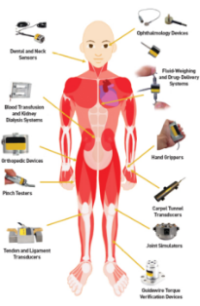


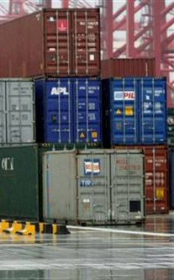


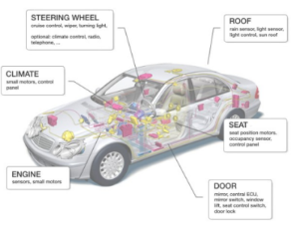
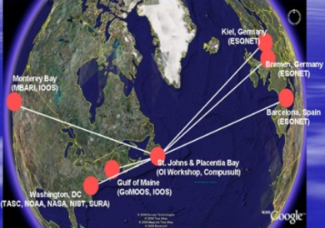
Transducers (Sensors & Actuators) are used everywhere
Networked sensors connected in wired or wireless ways can be used in many applications:
  Aerospace
  Automobile
  Global warming / environmental monitoring
  Global asset tracking (supply chain, secure container)
  Green / smart home and building
  Health condition monitoring
  Industrial automation
  Manufacturing
  Smart Grid & more ….
Security
Wireless
Privacy
Web Access

Slide 47
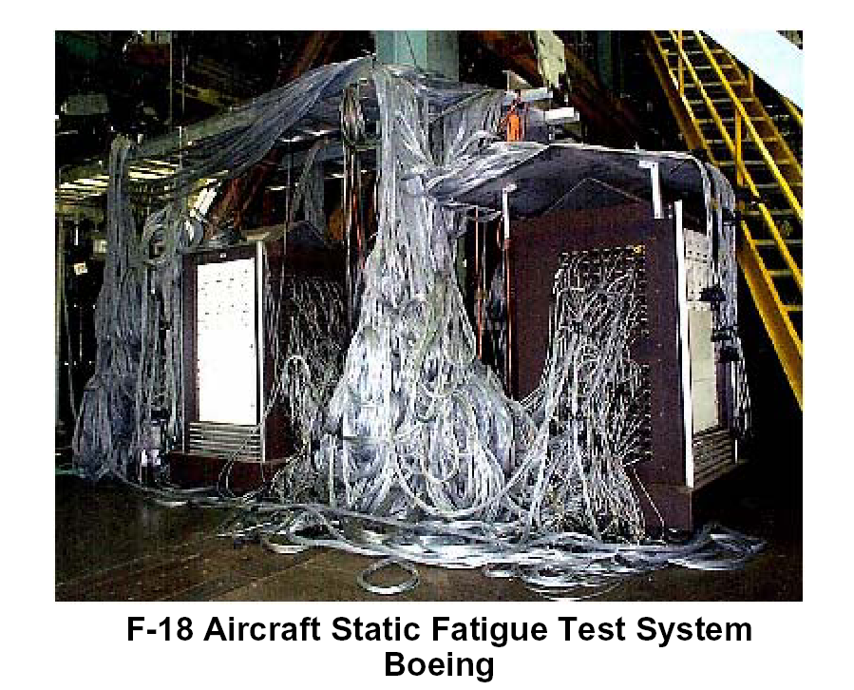
How about this ?
A real world “Sensor Instrumentation” problem
Image courtesy of National Instruments

Slide 48
Smart Transducers - IEEE 1451 Definition:
“A smart transducer is a transducer that provides functions beyond those necessary for generating a correct representation of a sensed or controlled quantity. This functionality typically simplifies the integration of the transducer into applications in a networked environment.”
In other words, an IEEE smart transducer is either a sensor or actuator that can identify and describe itself, has processing capability to present sensor data or actuation values, respectively, with measurement units, and has network access capability, and is easy to use (enabling plug-and-play).
Notes:
Should be 21451. I suggest make the underlined text white to stand out better for them to retain the key features.

Slide 49
Main Features of Smart Transducers
Transducer = sensor or actuator
Network ready
Self-identification
Self-description
Self-calibration (enable)
Time-aware
Location-aware
Intelligence (signal processing, event notification, data fusion…)
Output in physical units
Standard-based wired or wireless communications

Slide 50
System Approach of Standardized
Smart Transducers Interfaces ( IEEE 1451 )
Physical
Connection
of Sensors/
Actuators
Wired or Wireless
Interface
Network
Connection
of Sensors/
Actuators
Transducer
(or Sensor) Node
(TIM)
Network Node
(NCAP)
Common Network Services
( IEEE 1451.1 )
Different Services
( IEEE 1451.1.X )
XDCR
ADC
XDCR
DAC
Client
Physical
parameters
to be
measured
(ex: t, p,)
processor
XDCR
D I/O
XDCR
?
Common
Command Set
( IEEE 1451.0 )
Client
Transducer
Electronic
Data
Sheet (TEDS)
A mix of sensors & actuators in a node for distributed control applications
Application
Any
Network
XDCR = sensor or actuator
-- items standardized
Notes:
In industry, a device in a sensor network is commonly refer to as a Sensor Node which include sensing and a little actuation function.
However, in IEEE 1451 standard, we are more precise and refer them as transducer node. For easier understanding to a layman, it can be recognized as a sensor node.

Slide 51
IEEE 1451.X standards adopted by or jointly developed with ISO/IEC JTC1 SC31 as:
ISO/IEC/IEEE 21451-X standards
ISO/IEC/IEEE 21450 =
IEEE 1451.0
Notes:
Can connect wired, wireless….

Slide 52
IEEE 1451 Family of Standards
The IEEE 1451 family of smart transducer interface standards for sensors and actuators consist of :
    1451.0 – Common commands, functions, messaging, and transducer electronic data sheet formats (TEDS) ---------------------------------------------------- Std published and is planned to be revised
    P1451.1 – Common network services for smart sensors and actuators --- Std being revised
    P1451.2 – Serial interface for smart sensors and actuators ------------------ Std being revised
    P1451.4 – Analog interface and TEDS for smart transducers ----------------- Std being revised
    1451.5 – Wireless interface for sensors and actuators, that can support multiple wireless communication protocols, e.g., 802.11, ZigBee, Bluetooth, and 6LoWPAN to facilitate sensor data interoperability among heterogeneous networks ------------------------------- Std published and is planned to be revised
    1451.7 – RFID to sensor interface ------------------ Std published and is planned to be revised
    P1451.1.4 – XMPP interface for secure sensor data access -------------- Std being developed
    P1451.001 – Signal treatment applied to smart transducers --------------- Std being developed
    P1451.99 -- Harmonization of IoT devices and systems ------ Std project to start on 1/1/2017
    Study group on low-power applications and potential for a 1451.X standard –----------- active
The family has become:
  ISO/IEC/IEEE 21451-X family of standards
  This is done under the ISO/IEEE Partner Standards Development Organization (PSDO) Cooperation Agreement on ISO/IEEE document adoption and joint development.
Notes:
Based on the concept of the Cyber Physical Systems (CPS) architecture, IEEE 1451 smart sensor transducer interface standards and IEEE 1588 precision synchronization standards can support CPS.
IEEE 1451 defined Transducers as sensors or actuators.
Definition of IEEE smart transducers is sensors and actuators with self-identification, self-description, intelligent signal processing, and network access capabilities.
TEDS (Transducer Electronic Data Sheets) are electronic data sheets describing sensor and actuator characteristics that can be attached to the sensors and actuators via memory chips, instead of paper data sheets.
RFID (Radio Frequency IDentification) is the wireless non-contact use of radio-frequency electromagnetic field to transfer data, for the purposes of automatically identifying and tracking tags attached to objects.
XMPP is a method for transporting IEEE 1451 messages over a network using eXtensible Messaging and Presence Protocol (XMPP) to establish session initiation, secure communication, and characteristic identification between networked client and server devices using device meta-identification information based on the IEEE 1451 Transducer Electronic Data Sheets (TEDS). XMPP provide capability for access to thousands of sensor access via Internet.
The XMPP protocol has also been used for publish-subscribe systems, signalling for VoIP, video, file transfer, gaming, Internet of Things applications, such as the smart grid, and Social networking services.

Slide 53
IEEE 1451 Changes the Sensor Measurement Paradigm
Creation of a Measurement Data Model
  Recognizes that a measurement is more than a number—it is important to associate units (Celsius for temperature, Pascal for pressure, etc.)
  Gives transducers an Identity (self-identification of sensor via a TEDS).
  Improves the accuracy of measurements (via the calibration TEDS).
  Associates time, location, etc.
Notes:
Should be 21451 when ISO/IEC is inserted in front of IEEE. I add Celsius.

Slide 54
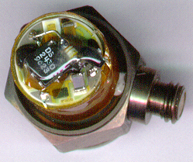
TEDS is a Key Enabler for Smart Transducers
Example for IEEE 1451.4
TEDS provides automatic recognition of device personality and attributes at power on or through query at any time.
Simplest: Basic TEDS (21451-4)
  Manufacturer ID (14 bits)
  Model Number (15 bits)
  Version Letter (7 bits)
  Version Number (6 bits)
  Serial Number (24 bits)
TEDS

Slide 55
via Transducer Electronic Data Sheets (TEDS)
Sensor Identification
TEDS, a memory device attached to a smart transducer node that stores metadata, transducer identification, measurement range, calibration, correction data, user and manufacture-related information, which can be used for transducer self-identification and description. Virtual TEDS, not standardized, is also practiced.
Many different TEDS are defined:
  Meta-ID TEDS
  Transducer Channel TEDS
  Physical TEDS
  Calibration TEDS
  Frequency Response TEDS
  Manufacturer-defined TEDS
  Application Specific TEDS
  Geo-location TEDS
  User-defined TEDS, e.g., Health, etc.

Slide 56

P1451 facing

Slide 57
Industrial Internet Revolution is here
Industry consists of many Physical Systems
The Internet revolution brings Cyber Systems
The Industrial Internet Revolution lead to
  Cyber Physical Systems (CPS)
  Industrial Internet of Things (IIoT)
  Internet of Things (IoT)
  Internet of Every Things (IoET)
CPS are hybrid networks of cyber and physical components integrated to create systems that have adaptive and predictive capabilities. These systems can respond in real-time to enhance system performance automatically or through human interactions.

Slide 58
Cyber Physical Systems in different Sectors
Aerospace and automobile industries
Smart buildings, homes, and structures
Smart healthcare and emergency response
Smart Grid
Smart manufacturing
Smart transportation
Smart war fighting
…

Slide 59
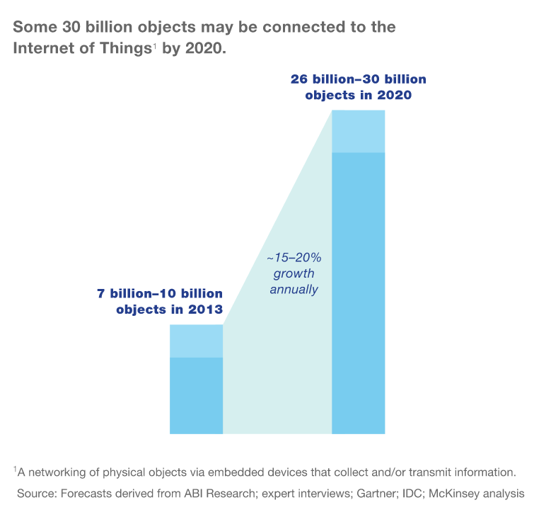
IoT Sensor Growth
Internet of Things Connected Devices to Almost Triple to Over 38B Units by 2020
  Juniper Research (July 28, 2015)
Gartner Says 4.9 Billion
Connected "Things" Will Be in Use
in 2015—by 2020, 25B will be in use
  Gartner Research (November 11, 2014)
McKinsey predicts 20-30B by 2020
with 15-20% annual growth
  McKinsey (December 2014)
15-20% Annual Growth

Slide 60
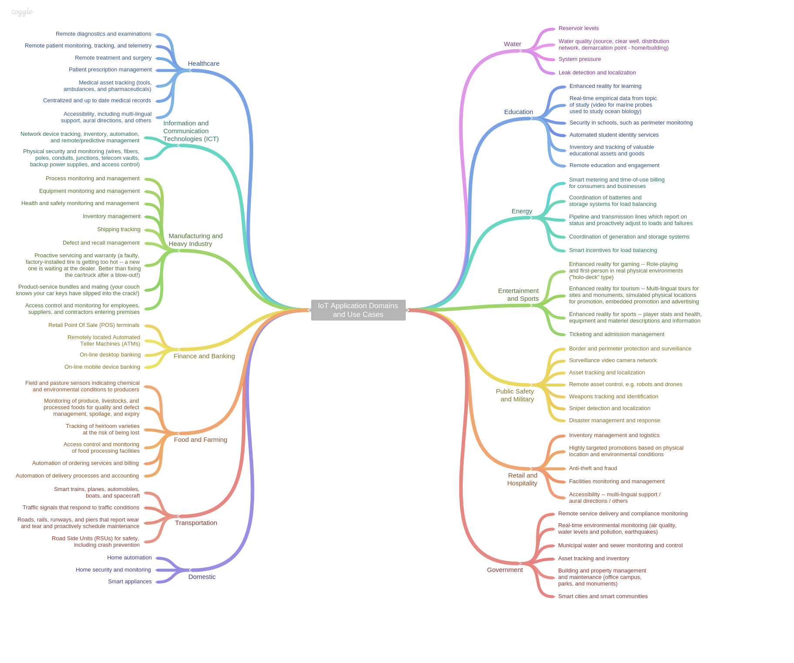
ch
Healthcare
Water
Information & Comm Techs
Education
IoT Application Domains & Use Cases Mindmap
Energy
Manufacturing
Infotainment
Finance
Public Safety, Military
Agriculture
Hospitality, Retail
Transportation
Government
Residential
In all these applications and use cases, smart sensors can play key roles to enable IoT functions. Adjust 21451 to meet challenges.
Courtesy of ISO/IEC/JTC1 SWG5

Slide 61
For More Information About
IEEE I&MS TC-9 Sponsored IEEE Standards
IEEE 1451 website: http://ieee1451.nist.gov
ANSI/IEEE 1588 (ISO/IEC 61588, or PTP), Standard for a Precision Clock Synchronization Protocol for Networked Measurement and Control Systems.
website: http://ieee1588.nist.gov,
Published IEEE standards can be purchased at
  http://www.techstreet.com/cgi-bin/results
  Contacts: Kang Lee, kang.lee@ieee.org

Slide 62
Thank You!
Questions?

Slide 63
TSCC Fall 2016
Coding and Data Compression
Subcommittee Report
November 7, 2016
ITC 2016

Slide 64
Membership
Stephen Nicolo, Chair.
  John Carlson – GDP Space Systems
  Bob Mayer – GDP Space Systems
  Michael Marcellin- Univ. of Arizona
  George Nelson - Delta Information System
  Gary Thom - Delta Information System

Slide 65
Sub-Committee Focus
Data Compression and Coding
Error Correction
Current standards – updates
  IRIG 106

Slide 66
Significant Activity
iNET was rolled into IRIG 106 Chapters 21 thru 28. Preliminary Pink Sheets for Chapters 21 through 28 were reviewed for the purpose of determining there relevance to TSCC Coding and Data Compression Subcommittee.
  It was determined that only Chapters 27 and 28 contain any reference to the topic of Coding and Data Compression. These references only indicate that Low Density Parity Check should be applied to RF MAC frames as the Forward Error Correction code.
  The complete paragraph number and title as well as the text relating to LDPC from each chapter is included on the following page.

Slide 67
Significant Activity
IRIG 106 Chapter 27:
  27.2.1 Data Link Layer Framing
    Forward error correction is added to the RF MAC frames to create Low Density Parity Check (LDPC) blocks suitable for transmission over the RF link. Details of the higher levels of this protocol are covered in Chapter 28.
  27.4.5 Low-Density Parity-Check (LDPC)
    Each codeblock shall contain one 512-byte RF MAC frame or, if the RF MAC frame is not 512 bytes, padding bytes with values of zero shall be added after the FCS to fill a 512-byte codeblock before encoding. The FEC code shall be a Low-Density Parity-Check (LDPC) code as specified in CCSDS 131.1-O-2, September 2007.
  27.4.5.1 Encoder Implementation
    A reference implementation of the LDPC is available from ref [4] using the values r=2/3 and k=4096.
IRIG 106 Chapter 28:
  28.2.1 Data Link Layer Framing
    Forward error correction is added to the RF MAC frames to create LDPC blocks suitable for transmission over the RF interface. Details of the lower levels of this protocol are covered in Chapter 27.

Slide 68
Significant Activity
IRIG 106 Appendix Q: Extended Binary Golay Code (Error Correction Code): Pink Sheets TG Task 144 Submitted for review and comment along with Chapter 7
  Extended Binary Golay Code
    This is an error correcting code that adds 12 bits of error correction code to a 12 but word (24 bits total).
    Can detect up to 7 bit errors and can correct up to 3 bit errors in a 12 bit word.

Slide 69
Significant Activity
IRIG 106 Appendix N: Telemetry Transmitter Command and Control Protocol: Pink Sheets distributed for review.
  Appendix N Update Summary
    Added Low Density Parity Check (LDPC) related commands to basic command set – FE(FEC) command.
    Removed other FEC codes.
    Added Space Time Coding (STC) related commands to basic command set – ST(STC) command
    Moved the following commands from the Extended Command Set to the Basic Command Set:
      DS(DSRC) – Data Source
      ID(IDP) – Internal Data Pattern
      CS(CLKS) – Clock Source
      IC(ICR) – Internal Clock Rate
      TE(TEMP) – Internal Temperature
    Moved the differential encoding (DE) command from the basic Command Set into the Extended Command Set; clarified applicability to modulation mode (I.e. SOQPSK only)
    Added STC Disabled Transmitter Communication Example

Slide 70
Significant Activity
IRIG 106-15: Forward Error Correction (FEC) Codes
  LDPC Codes were added in Appendix R
    Codes were CCSDS LDPC Codes
Video Compression
  H.264: Mature and used widely in commercial and government applications
    Last updated in 2014
    A new version was just approved in 2016, but not yet published
  H.265: New standard offering banwdidth saving up to 50% over H.264. It was generally developed for higher resolution applications (i.e. 4K)

Slide 71
Open Actions
Work on Committee Membership – Looking for members
Continue to look for additional applicable specifications

Slide 72
“TSCC Fall 2016
Recorder and Reproducer
Committee Reports”
November 7, 2016
ITC
Phoenix, AZ

Slide 73
Sub Committee Membership
Mark Buckley (Telspan Data), Chairman
Albert Gabaldon, Alternate Chairman
  Balázs Bagó (Zodiac)
  Bob Baggerman (Zodiac)
  Paul Carrion (Calculex)
  Tim Chalfant
  Chris Dehmelt (L-3 Comm Telemetry East)
  Justin Denning
  Paul Ferrile (ATAC)
  Tim Gatton (Wideband)
  Dan Green (Smartronix)
  Eric Lamphear (Telspan Data)
  Mike Lockard (EMC Corp)
  Hung Mach (Boeing)
  Doug Novak
  Johnny Pappas (Zodiac)
  Jason Phillips (RT Logic)
  Christian Rueck (Databus Tools)
  Rob Trepa (Edge Consulting)
  Malcolm Weir (Ampex)
  Craig Wierzbicki (TTC)
  Rick Williams (SDS)

Slide 74
Sub-Committee Focus
Data Recorders, Ground and Airborne
Standards in Place
  IRIG 106-15 – Range Commanders Council (RCC) Telemetry Standards
  http://www.wsmr.army.mil/RCCsite/Pages/Publications.aspx
  STANAG 4575 – North Atlantic Treaty Organization (NATO) Standard Agreement (STANAG) – NATO Advanced Data Storage Interface (NADSI) Allied Engineering Documentation Publication (AEDP)
  http://www.nato.int/STRUCTUR/AC/224/standard/4575/4575.htm
  ANSI INCITS 175-1999 (R2004) 19mm Type ID-1 Recorded Instrumentation Digital Cassette Tape Format (revision and redesignation of ANSI X3.175-1990 (R1995)
  MIL-STD-2179 – Helical Digital Recording Format For 19-MM Magnetic Tape Cassette Recorders/Recorders
Notes:
IRIG 106 The Telemetry Group (TG) of the Range Commanders Council (RCC) has prepared this document to foster the compatibility of telemetry transmitting, receiving, and signal processing equipment at the member ranges under the cognizance of the RCC. The Range Commanders highly recommend that telemetry equipment operated by the ranges and telemetry equipment used in programs that require range support conform to these standards.
These standards do not necessarily define the existing capability of any test range, but constitute a guide for the orderly implementation of telemetry systems for both ranges and range users. The scope of capabilities attainable with the utilization of these standards requires the careful consideration of tradeoffs. Guidance concerning these tradeoffs is provided in the text. The standards provide the necessary criteria on which to base equipment design and modification. The ultimate purpose is to ensure efficient spectrum utilization, interference-free operation, interoperability between ranges, and compatibility of range user equipment with the ranges.
IRIG 106 Chapter 10 The purpose of this chapter is to establish a common interface standard for the implementation of digital data acquisition and recording systems by the organizations participating in the Range Commanders Council (RCC). This standard does not imply hardware architecture such as the coupling of data acquisition, multiplexing, and media storage. The required interface levels are contained in this standard (see a through e below). In addition, declassification requirements are discussed in section 10.8, ground based recording in section 10.10 and data interoperability requirements in section 10.11.
a. Data Download and Electrical Interface, which is the physical interface for data access, is defined in section 10.4.
b. Interface File Structure, which defines data access structure, is described in section 10.5.
c. Data Format Definition, which defines data types and packetization requirements, is defined in section 10.6.
d. Recorder Control and Status, which defines command and control mnemonics, status, and their interfaces, is described in section 10.7.
e. IEEE 1394B Interface To Recorder Removable Media is defined in section 10.9.
f. Ground Recorder Interface, which defines unique interoperability requirements of a ground recorder, is described in section 10.10.
g. Data Interoperability, which defines requirements for the annotation, modification and exchange of recorded data, is described in section 10.11.
STANAG 4575 The aim of this agreement is to promote interoperability for the exchange of data among
North Atlantic Treaty Organisation (NATO) Intelligence, Surveillance, and
Reconnaissance (ISR) Systems. The NATO Advanced Data Storage Interface (NADSI)
defines the standard for an interface to allow cross-servicing of ISR platforms by NATO
nations’ ground stations.
The NADSI STANAG defines a multiple layer protocol for the lower levels of the
interface channel as defined in the International Standards Organisation - Open Systems
Interconnection model (ISO/IEC 7498-1). Additionally, this STANAG is part of the
NATO ISR Interoperability Architecture (NIIA) which includes the data format standards
STANAG 7023 for primary and STANAG 4545 for secondary imagery. The NADSI
standard alone does not guarantee interoperability. Compatibility must also be assured at
other protocol layers. Certifiable implementation of the NADSI for support of
interoperability is subject to constraints not specified in this STAN
ANSI ID-1 19-mm Type ID-1 Recorded Instrumentation Digital Cassette Tape Format (revision and redesignation of ANSI X3.175-1990 (R1995)
Establishes the format of information on 19-mm type ID-1 instrumentation digital cassettes. It specifies the dimensions and locations of the helical data, control, time code, and annotation tracks. Also, it defines the format and recording requirements of the data blocks forming the helical data record containing digital instrumentation and other associated data and specifies the content, format, and recording method for the control record. This standard also specifies the recording requirements for the longitudinal records contained in the annotation and the time code tracks.
Title MIL-Std 2179
HELICAL DIGITAL RECORDING FORMAT FOR 19-MM MAGNETIC TAPE CASSETTE RECORDER/REPRODUCERS
Naval Air Systems Command
Publication Date:
Oct 30, 1998
Scope:
The purpose of this standard is to ensure the ability to exchange digital data within the appropriate community of users in the Department or Defense, to standardize the cassettes and the format of the data for 19-mm magnetic tape and to ensure that a recording made on one machine can be replayed on any other machine that conforms to this standard.
This standard establishes the format of the data as recorded on the tape, the principal properties of the tape, and the dimensions and physical properties of three sizes of cassettes.
This standard defines requirements for the purchase of magnetic tape recorder/reproducers which record and reproduce or reproduce digital data using a rotary helical scan on 19-mm tape cassettes.

Slide 75
Significant Activity
RCC Telemetry Group Recorder & Reproducer Committee
  IRIG 106-17 Chapters 6/9/10/11 Pink Sheets Out for Review
STANAG 4575, AEDP-6 Ratification
  Released Ed 4 to NSA for ratification and subsequent release to member nations for promulgation.

Slide 76
Significant Activity
RCC Document 106-17 Chapter 10
TSCC R&R to take a more significant roll in CR reviews & recommendations
  Help ease the TG R&R work load & approval process
2017 release CR’s
  CR 56: Update Programmers Handbook & Test Methods to IRIG106-13 Chapter 10
  CR 77: Revise 118 Test Methods & TSCC to Investigate Open Source Validator SW
  CR 79: Fibre Channel Format 1 (FC-FS Layer, All)

Slide 77
Significant Activity
RCC Document 106-17 Chapter 10
2017 release CR’s
  CR 80: CH9/10 Clarifications & Corrections, to be Reviewed by TG R&R
  CR 86: Implement new Chapter 6 command to publish setup record TMATS
  CR 88: Remove Chapter 6 Commands from Chapter 10
  CR 89: Create new Chapter 11 which is the Chapter 10 section 10.6 data format only
  CR 91: Remove Fibre Channel & Firewire as required recorder interfaces & add Ethernet

Slide 78
Significant Activity
RCC Document 106-17 Chapter 10
2017 release CR’s
  CR 92: Version 2 Chapter 10 packet header
    Moved to 19 Release
  CR 93: New format 2 time packet, Network/IEEE-1588
  CR 94: Revised Chapter 10 UDP header to version 2
  CR 95: Revise section 10.9 for RMM clock to be optional

Slide 79
Significant Activity
RCC Document 106-17 Chapter 10
2017 release CR’s
  CR 96: New message packet format for change of value data words
    Moved to 19 Release
  CR 97: Add new H.265
    Moved to 19 Release
  TSCC CR 16-001: Add “IRIG Time Source” bits to Time Format 1

Slide 80
Open Actions
TSCC –
  Review Chapter 10 section 10.8 “Declassification” for removal from the standard
  Review Ethernet payload identification related to range needs
  TSCC Web site to be updated for public document access and storage
  Validator
    The RCC has requested the TSCC to develop a recorder validation tool (Chapter 10 Validator)
      Software/hardware definition, procedure
      Would include maintaining a “Golden File” of data. Any issues of TSCC maintaining files with ITF? Would be maintained on webpage.
      We have a volunteer to lead the effort…
      At least two versions exist…
Notes:
A new Ch-10 task will be submitted to support work toward updates for the 09 release. New capabilities planned for the 09 spiral include-
Limited Data Mining/Retrieval
RMM Recorder Set-up
Ganging Multiple RMMs
Circular buffering/Loop Operations
1553 C&C (as an active RT)
New Data Types- AFDX (ARINC 664), Serial (like NEMA), 1588, CAN
TMATS Definitions for Missing Data Types (Firewire, EtherNet, …)

Slide 81
ETSC
Report

Slide 82
Open Actions
Track IRIG 106-15 update process
Track the update process of IRIG 118
IEEE 802.n and UWB (as a basic standard for
wireless intra-aircraft RDA-networking)
Track emerging standards of Cognitive Radio Systems, IEEE 801.15&22, IEEE1900.1/2/4,
ETSI TR102 802/803
----------------------------------------------------------------------

Slide 83


New Technology Impact on Test
Conference, Exhibition, Short Courses
June 13th - 15th , 2017
Toulouse, France
Call for Papers online :
www.etc2016.de
in cooperation with:
European
Chapter

Slide 84
Website Status
TSCC website is being used
  Recorder committee and MDL users group are only users to date!
Webmaster Bob Baggerman
www.tscc.org

Slide 85
TSCC Collaboration Tools
November 7, 2016

Slide 86

Intro
Bob Baggerman
  Zodiac Data Systems
I wear many hats including
  www.irig106.org
  www.tscc.org (administrator)
Contact Info
  bob.baggerman@zdsus.com
  bob@baggerman.org
  bob@irig106.org
  admin@tscc.org

Slide 87

TSCC Workflow
What We Do
  TSCC → Telemetry Standards Coordination Committee
  TSCC members discuss telemetry technology
  TSCC members produce standards recommendations documents
How We Do It
  Email discussions
  Infrequent meetings
  Shared “documents”
Why We Do it
  Don’t know

Slide 88
Better Tools – Why and How
Why TSCC workflow tools are needed
  TSCC membership is distributed
  TSCC membership is very heterogeneous
    No common tools
  Need to collaborate better to be an effective organization
  Need better tools to collaborate better
    A low budget web site is our only shared resource
  ALL subcommittees can benefit from common tools
How to collaborate better
  Email tools
  Document tools

Slide 89
Tools – Email Lists
Email lists are easy to setup and use
TSCC already provides email list capability
  Used by Recorders / Reproducers for a long time
  Very good experience
    rr-all@tscc.org
    rf-all@tscc.org
  Based on GNU Mailman
    Web management interface
  Individuals can manage subscribe / unsubscribe
Every subcommittee should be using this!

Slide 90
Tools – Web Site Wiki
Current TSCC web site is a wiki
  Anyone can edit (like Wikipedia)
  Based on DokuWiki
Wiki combines
  Web formatting to maintain look and feel
  Allows easy editing and updating
Wiki lacks the features for effective collaboration

Slide 91
Tools – “Document” Collaboration
What is a Document
  MS Word document
  Google docs
  Web document
MS Word Documents
  Word is ubiquitous
  Shared Word documents are hard to configuration manage
Google Docs
  Works well for Google users
  Google Docs don’t easily integrate into web presence
  Doesn’t support other collaboration features

Slide 92
Tools - Confluence
Confluence is
  A web based product designed for collaboration
    Atlassian
  Easy to master
  Pages are created in a hierarchical fashion
  Previous versions of pages are kept
    Can view changes between revisions
  Suitably powerful web based WYSIWYG (almost) editor
  Allows attaching user comments and annotations
  Allows “watching” pages
  Allows attaching arbitrary files to pages
  Produces relatively attractive PDF or Word documents from pages
  Cheap for small organizations
    $10 / month for up to 10 users hosted
    $10 to purchase to self host

Slide 93
Tools – Confluence – How we use
Hosted on Atlassian web server
  tsccwork.atlassian.net
  Convenient link from www.tscc.org
Users
  One overall admin user account
  Each subcommittee has an admin user account
  < 10 users!

Slide 94
Tools – Confluence – How we use
Work spaces for each subcommittee
Subcommittees create pages
  Pages are hierarchical
  Informational pages
  Working documents
Working documents
  Documents for general review and comments
  Admin creates and edits these
  Subcommittee may want to share Admin login to two or three trusted people
  Members can review and comment
    Anonymous comments OK for now
    Can control access and security as needed if necessary

Slide 95
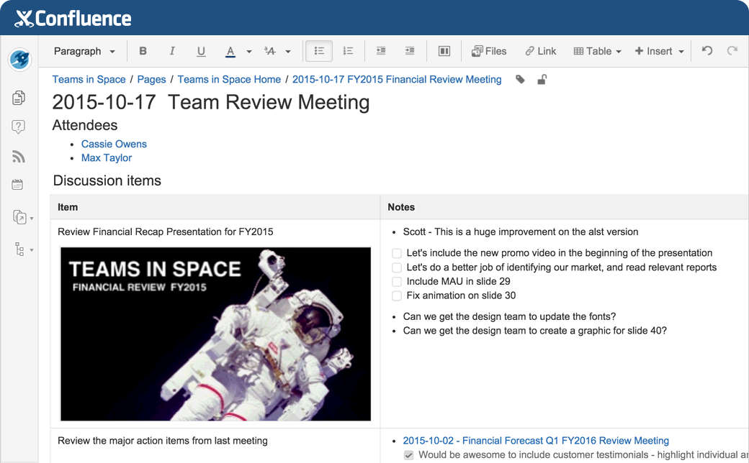
Tools – Confluence – Examples

Slide 96
Tools – Confluence – Examples
  Hopefully some live examples here!

Slide 97
Summary
Collaboration is the key to TSCC effectiveness
Email lists are easy and powerful, let’s use them!
Document collaboration is more difficult
  Let’s try Confluence and see if it suits our needs

